Slide 1

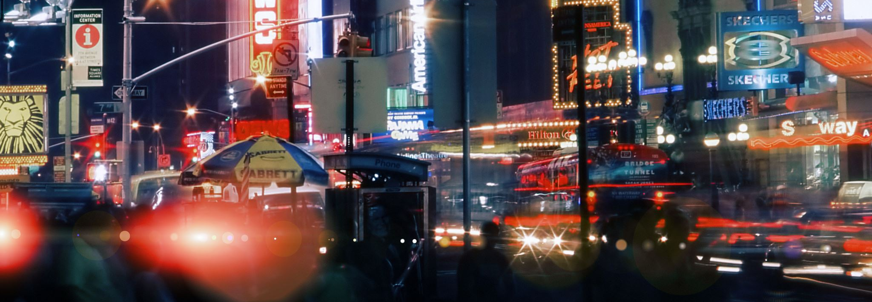

Holiday homes in the Big City
An analysis on Airbnbs in NYC

Slide 2
Background
Airbnb is an increasingly popular alternative to expensive hotels for tourists on a budget
It also gives renters and homeowners an opportunity to earn some income by subletting or renting their homes out when they are not using it

Slide 3
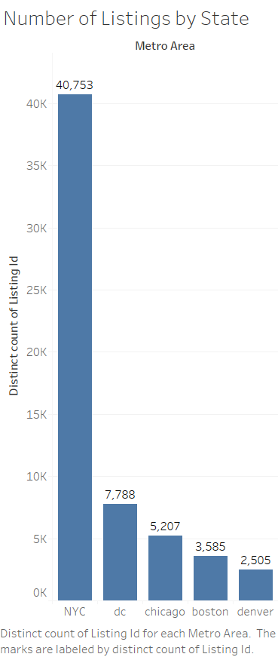
New York City, one of the top but expensive tourist destinations has a significantly high count of Airbnb listing

Slide 4
